Slide 1
Robot Mapping with Proprioceptive Spatial Awareness in Confined and Sensor-Challenged Environments
Jacob Everist
Advisor: Wei-Min Shen
Committee: Ramakant Nevatia
Committee: Behrokh Khoshnevis

Slide 2
Outline
Problem
Related Work
Approach
sensing, features, control, robot frame, mapping
Results
Conclusion

Slide 3
Problem
Environments that are sensor-challenged and confined are difficult to robotically explore and map
Pipes
Caves
External sensors such as cameras, sonar, and LIDAR may be become inoperable due to damage, occlusions, lighting and fluid conditions

Slide 4
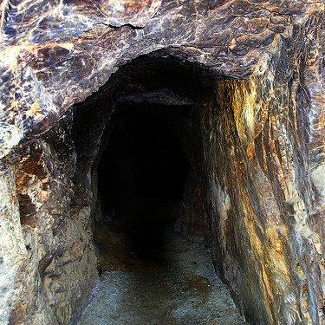
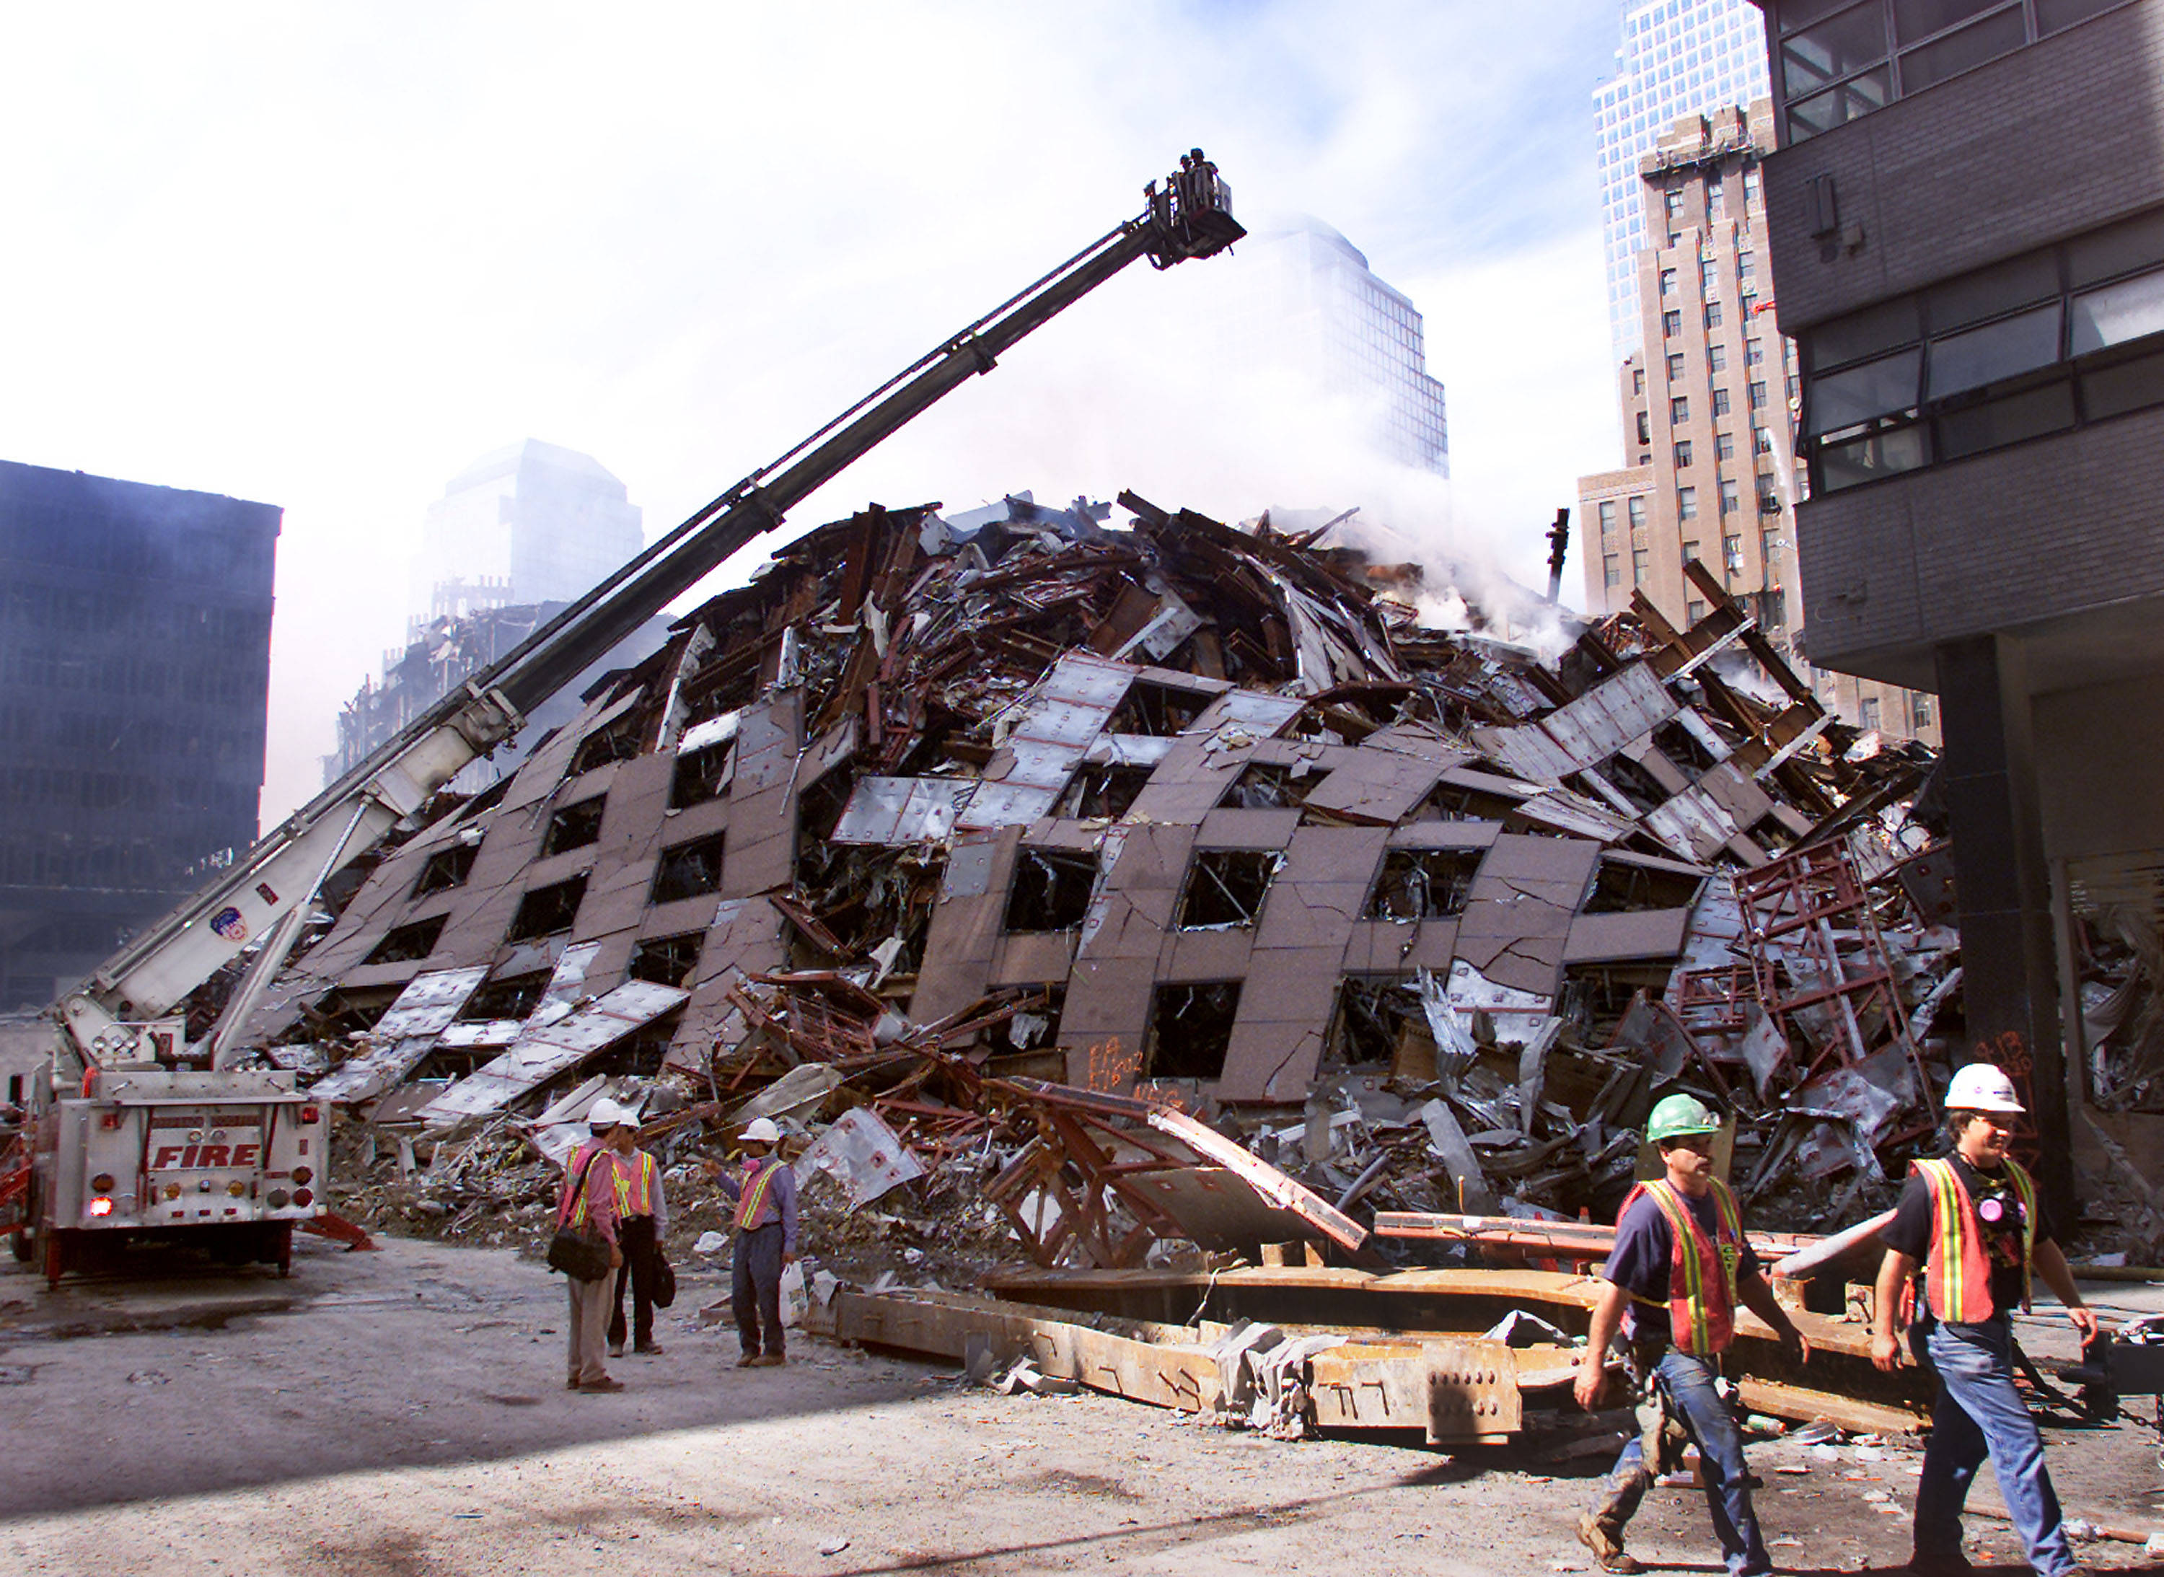
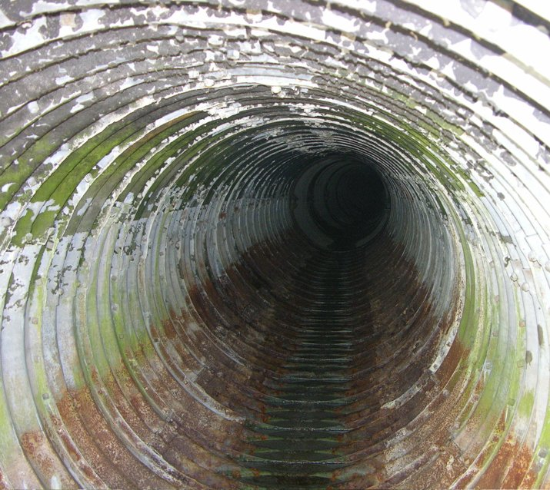
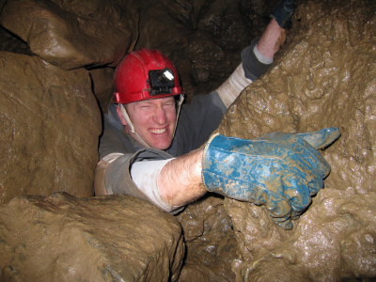
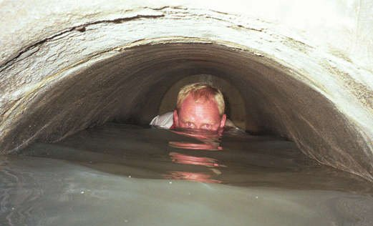
Environments

Slide 5
Motivation
Allow mapping and exploration of previously inaccessible environments
Flooded mines and caves
Pipes and sewers
Debris piles (INTERESTING)
Seek solution invariant to ambient fluids (air, transparent liquid, opaque liquid) (HARD)
Impacts
Cave exploration
Geology
Search and rescue
Pipe inspection (INTERESTING)

Slide 6
Mining Disasters
West Virginia, 29 dead, 2010
Utah, 9 dead, 2007
West Virginia, 12 dead, 2006
Kentucky, 5 dead, 2006
Alabama, 13 dead, 2001

Slide 7
Earthquakes
Haiti, 222570 dead, 2010
Sumatra, 1117 dead, 2009
Sichuan, 87587 dead, 2008
Peru, 514 dead, 2007
Java, 5749 dead, 2006
Pakistan, 80361 dead, 2005
Sumatra, 227898 dead, 2004
Iran, 31000 dead, 2003

Slide 8
Cave Exploration

Slide 9
Utility Inspection

Slide 10
Rediscover Old Infrastructure

Slide 11
Major Challenges
Variant fluids
Void space detection
Large chambers vs. slip of anchors
Reflections, distortions
Dark
Unstructured environment
Loose debris
Variable wall widths
No odometry or dead-reckoning
No GPS

Slide 12
Related Work
Mapping underground mines [Thrun04]
Pipe inspection [Fukuda89]
Flooded subterranean caves [Gary08]
Robot sub under sea ice [Kunz et al 08]
Geometric contact detection [Kaneko94], [Grupen, Huber93], [Haidacher02], [Mimura94]
Probing the boundary in an oil well [Mazzini11]
Initial work sensing void space [Everist09]

Slide 13
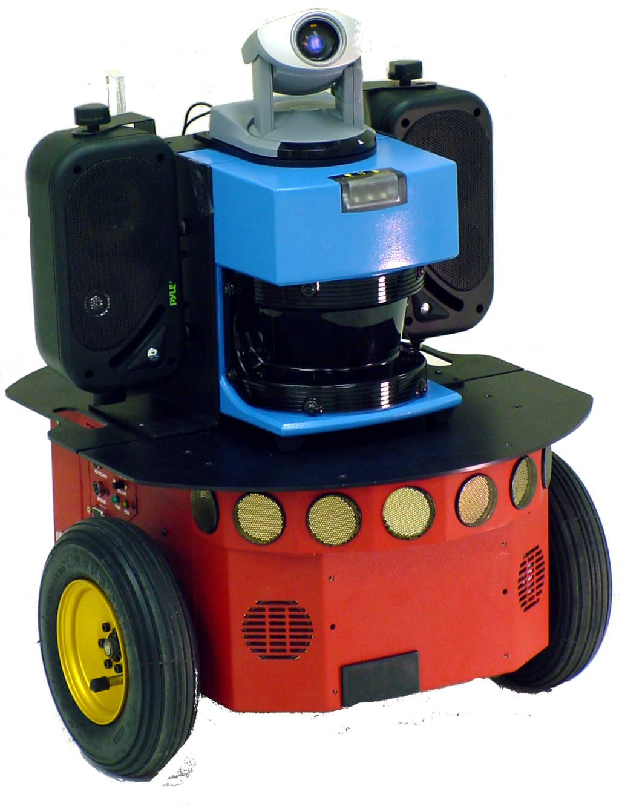

Slide 14
Wheels

Slide 15
Sonar
Wheels

Slide 16
LADAR
Sonar
Wheels

Slide 17
Vision
LADAR
Sonar
Wheels

Slide 18
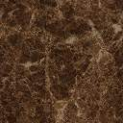

Slide 19
Incompatible Mobility

Slide 20
No Odometry

Slide 21
Failure by Proximity

Slide 22
Failure by Ambient Fluid

Slide 23
Approach
Algorithmic methods for robotically mapping
confined environments
proprioceptive sensors only
Use an articulated mobile robot
Use joint sensors and geometry to reconstruct robot posture
The robot should have many joints, known geometry, and a far reach
Use robot posture to identify void space
Sweep the body to build up information
Boundaries are indirectly inferred from mapped void space

Slide 24


Slide 25
Assumptions
Robot
All external sensors have failed
Only joint angle sensors are available
Dynamically set max torque
Body geometry is known
Environment
Confined
Pipe-like or tubular
Rigid walls
Flat ground, no slopes
Variable width (map and navigate)
Constant width (map, navigate, w/ junctions)
Simulation Only
Rigid Body Physics Engine
Bullet Physics: https://github.com/bulletphysics/

Slide 26
Evaluation
Success metric:
Can the robot generate a map of the environment?
Can the map be used by other robots for navigation?
Task:
Use the robot the explore and generate the map
Give the map to a new robot, direct it to a location on the map
Does it reach the target location?

Slide 27
Sensing
Features
Robot Frame
Control
Build Maps
Junctions
Max Likelihood Map

Slide 28
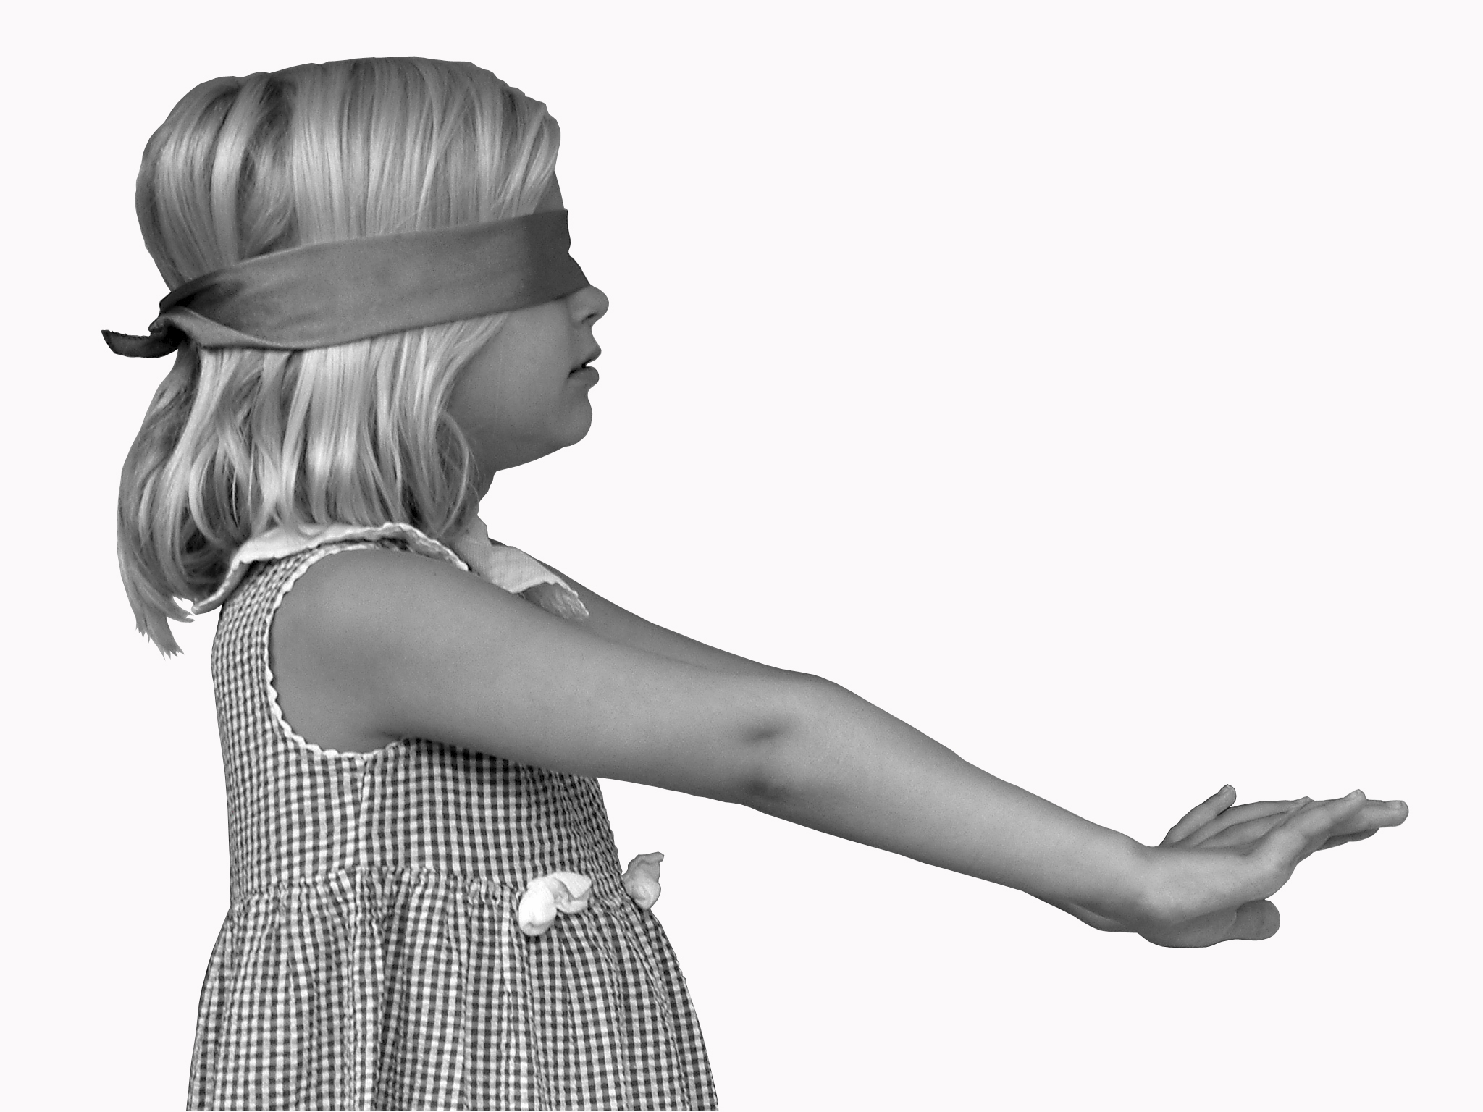
External Sensor Failure

Slide 29
Types of Sensing
Concepts from biology
Exteroception
sight, hearing, touch, taste, smell
Proprioception
relative position of neighboring parts of the body
strength of effort
Interoception
hunger, hot, cold, thirst, pain, etc.

Slide 30
Sensing with Proprioception
Obstacle detection is standard approach for mapping methods.
Use external sensors to detect boundaries
With proprioception only, using various contact detection strategies, we can get some boundary detection.
Existing methods:
contact detection (infer contact from geometry)
finger probing (detailed point contacts)

Slide 31
Sensing Void Space
Problem: without external sensors, how do we sense the environment with proprioception?
Solution: Build maps of void space using the robot’s body to sweep out the space
Inference of the boundary from shape of void space
Tells you where obstacle are not, not where they are

Slide 32
Proprioceptive Spatial Awareness
Use movement and body geometry to build awareness of space
Plot into a local map representing void space

Slide 33
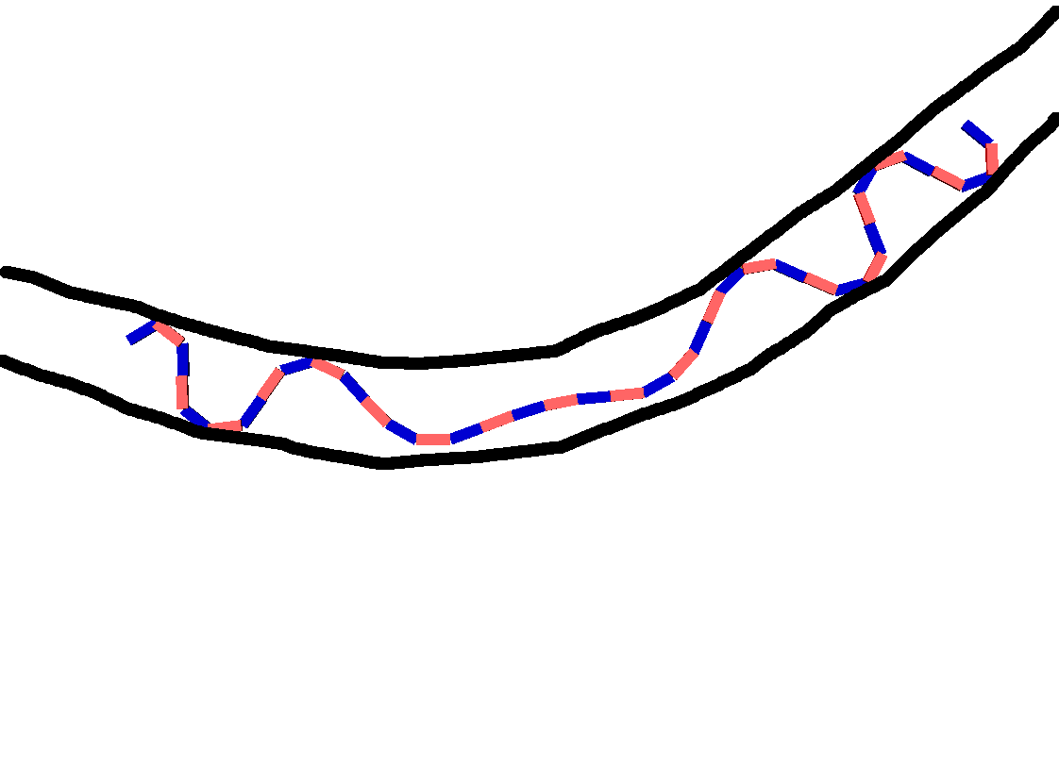

Slide 34
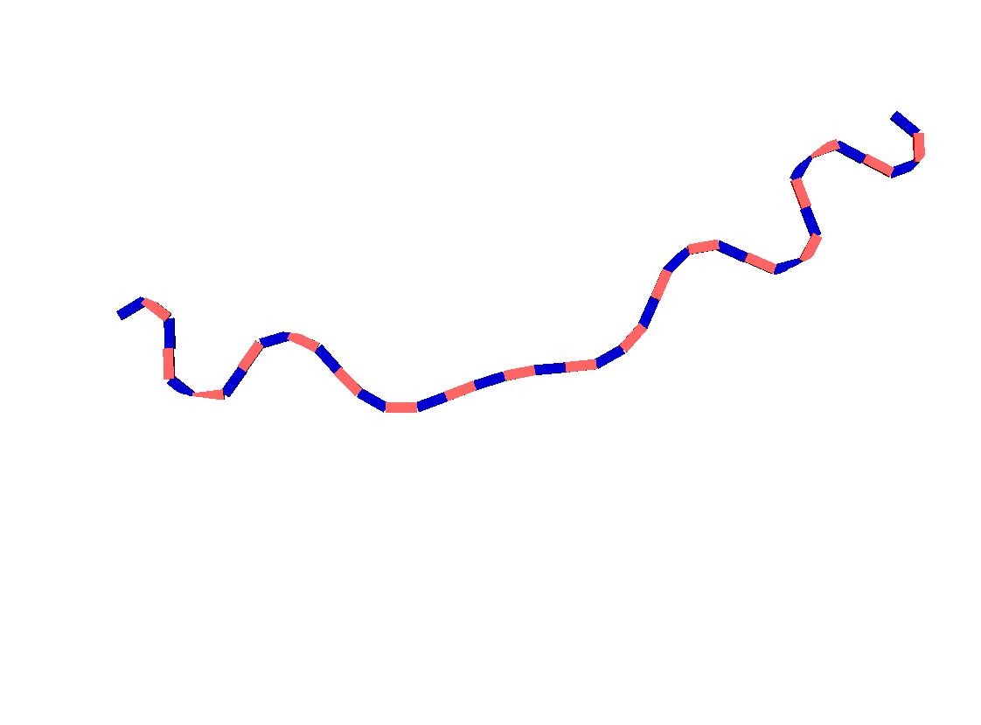

Slide 35
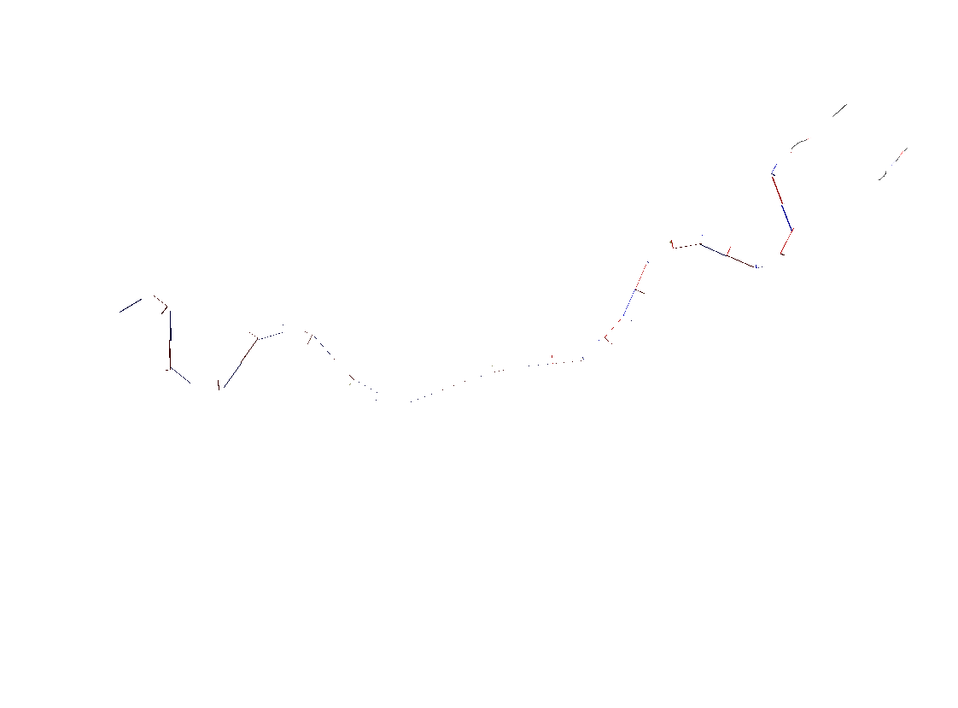

Slide 36
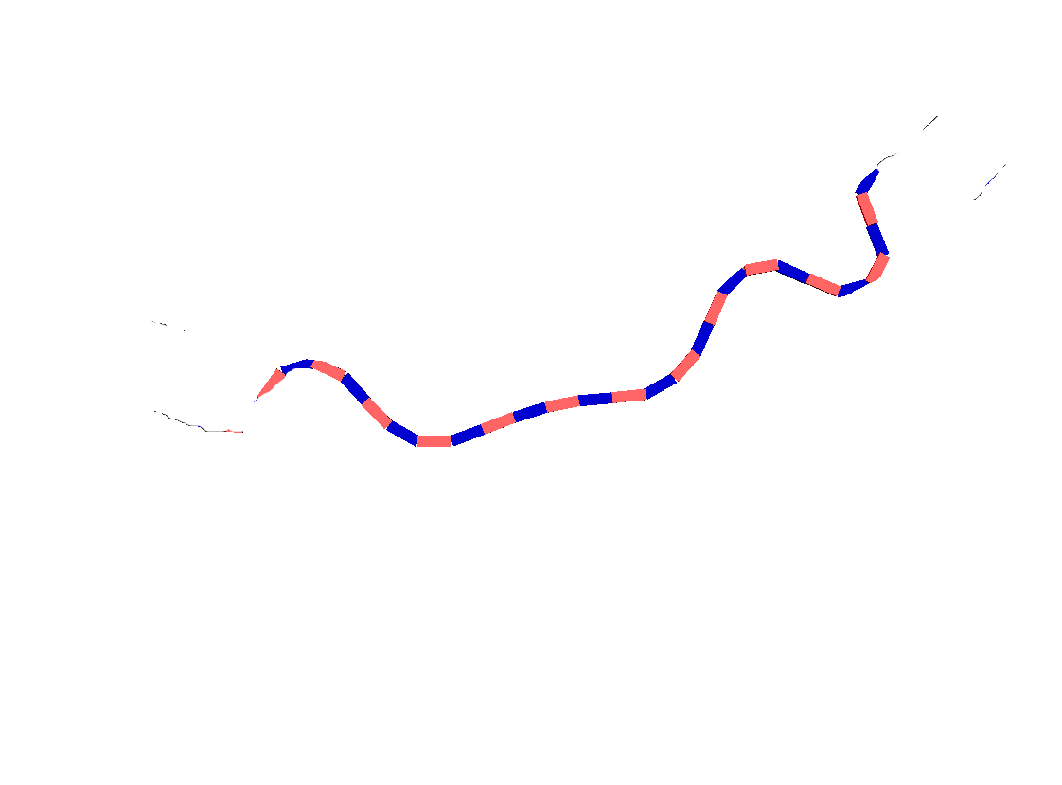

Slide 37
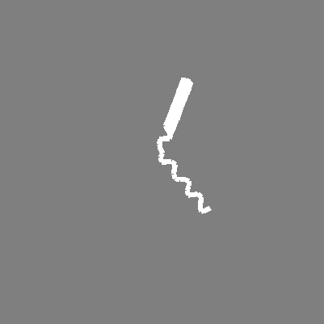

Proprioceptive Sensing
The posture image I_{t} , is captured at pose X_{t} by sweeping the body in one direction and anchoring in the other direction.

Slide 38
Sensing Void Space
Position and Orientation
Control and Locomotion
Environmental Landmarks and Features
Building Maps
Mapping with Junctions
Probabilistic Mapping

Slide 39
Environmental Landmarks and Features
In order localize the robot and build a map, we need some features of the environment to exploit
Candidates include:
Obstacles/walls
Corners
Shape features
Spatial features
bloom, arch, bend

Slide 40
Shape Features
Given a blob of void space, what properties can we extract?
Shape of the robot’s posture in space should give us information about the environment.
How can we extract this information and represent it in an useful way?

Slide 41
Shape Feature
“Spatial Curve”
Smoothed version gives us a curve representation of the space
Union of multiple void space images with medial axis give us graph representation of environment topology

Slide 42
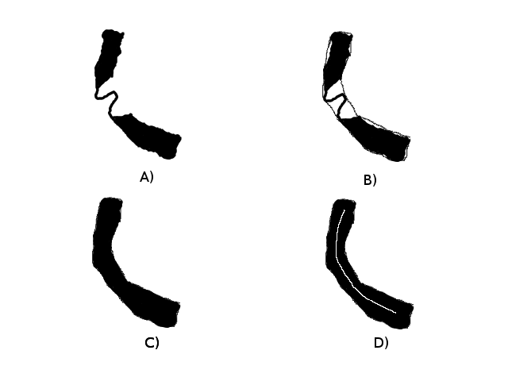
Spatial curve from Posture image
c_{t} = scurve(I_{t})

Slide 43
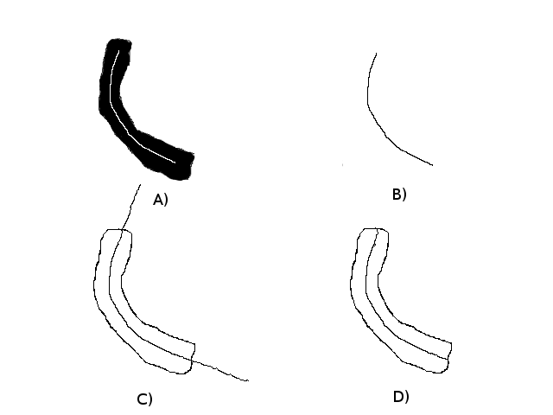

Slide 44
Spatial Features
We detect 3 different spatial feature from spatial images that are indicate of junctions:
blooms: swelling at the tip (CONSTANT WIDTH)
arches: internally swelling, “arched” anchors (CONSTANT WIDTH)
bends: sudden turn of spatial curve, crest is the bend point (DYNAMIC WIDTH)
Using these landmark features, we now include proximity with each other in the evaluation of motion estimation, branch state, and pose localization.
Using this approach, we are able to map and align the arms of a T and cross junction with ease.
The addition of the spatial features makes mapping and aligning the other junction much more rapid.

Slide 45
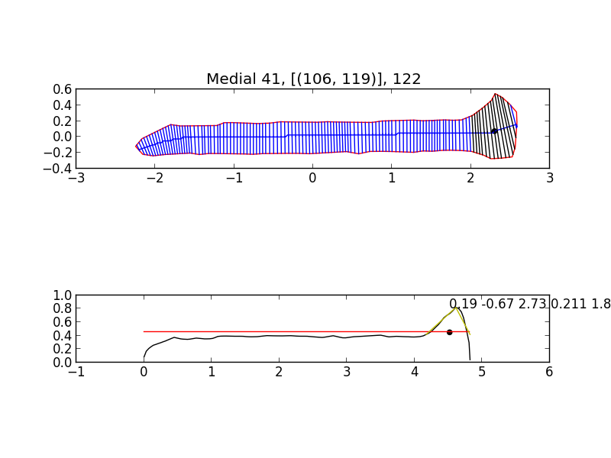

Slide 46
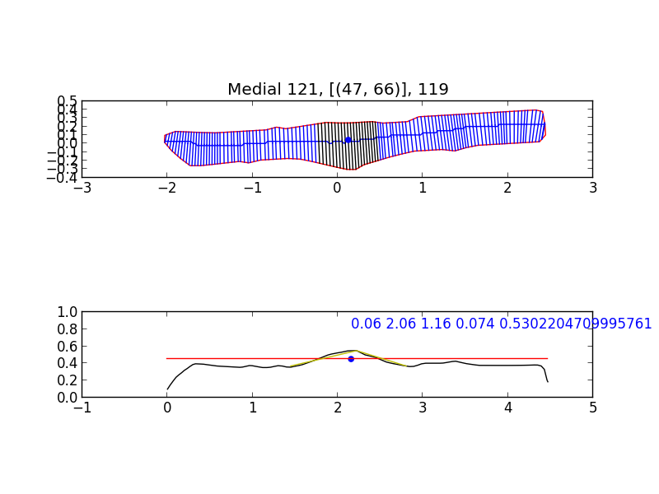

Slide 47
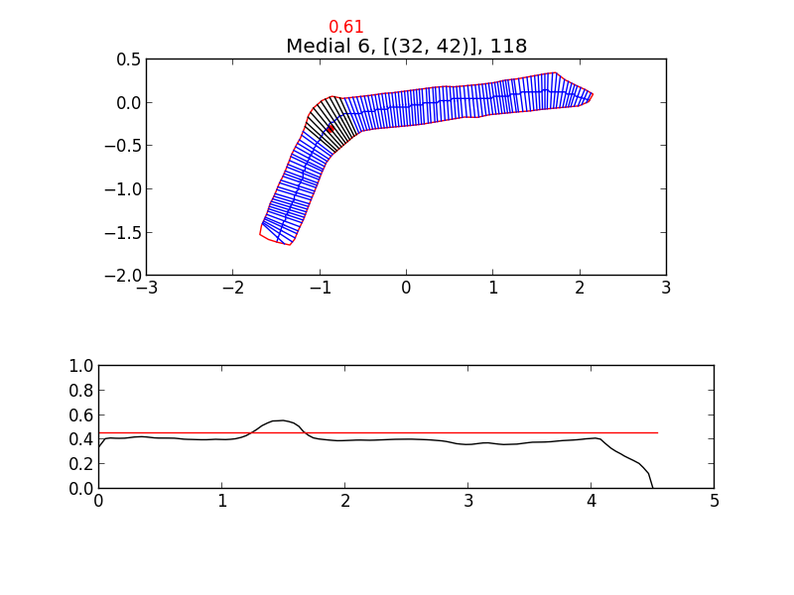
Width

Slide 48
Sensing Void Space
Position and Orientation
Control and Locomotion
Environmental Landmarks and Features
Building Maps
Mapping with Junctions
Probabilistic Mapping

Slide 49
Robot Frame
Articulated robot has no high-inertia center of mass to serve as its coordinate frame.
Individual segments are rotating and undulating
Need method to determine direction of snake robot.
Information not provided by individual body segments

Slide 50
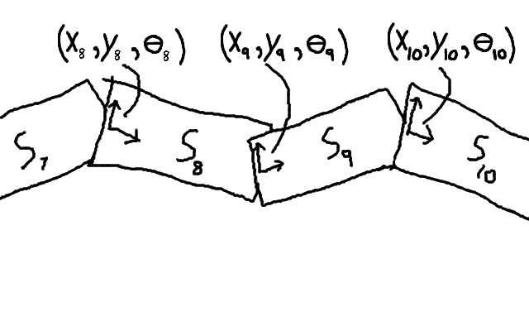

Slide 51
Posture Curve
Robot-centered Coordinate Frame
dynamically generated from B-spline
“Posture Curve” generated by smoothed B-spline with segment frame origins as input points (example)
Generates the Posture Frame for local coordinate system

Slide 52
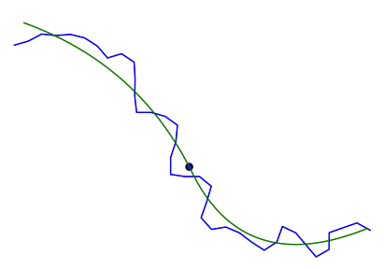

Slide 54
Sensing Void Space
Position and Orientation
Control and Locomotion
Environmental Landmarks and Features
Building Maps
Mapping with Junctions
Probabilistic Mapping

Slide 55
Control and Locomotion
Simulated robot control
Concertina locomotion
Snake control, backbone curves (Chirikjian)
Segmented behaviors
Adaptive anchoring
Smooth motion and compliance
Stability detection

Slide 56
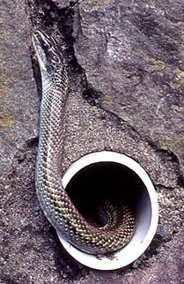
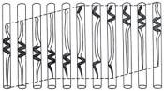
Concertina Motion
Gans 1980

Slide 57
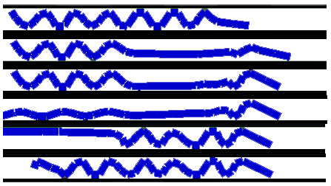
Gait Stages
Rest-State
Front-Extend
Front-Anchor
Back-Extend
Back-Anchor
Rest-State

Slide 58
Sensing Void Space
Position and Orientation
Control and Locomotion
Environmental Landmarks and Features
Building Maps
Mapping with Junctions
Probabilistic Mapping

Slide 59
Inputs
Locomotion Step
Posture Image
Pose

Slide 60
Initial Condition for Building the Map
Poses X₁ =(0,0,0) and X₂ = ?
Forward sweep I₁ and backward sweep I₂
Raw images
GPAC images, hull and spatial curve

Slide 61
4 Methods
Naive Approach
Axis Method
Junction Method
Probabilistic Method

Slide 62
In-Place Constraint
overlap spatial curves of X₁ and X₂
C₁ = scurve(I₁)
C₂ = scurve(I₂)
X₂ = overlap(X₁, C₁, C₂, d=0)
Generalized ICP algorithm to fit
Image of in-place fit

Slide 63
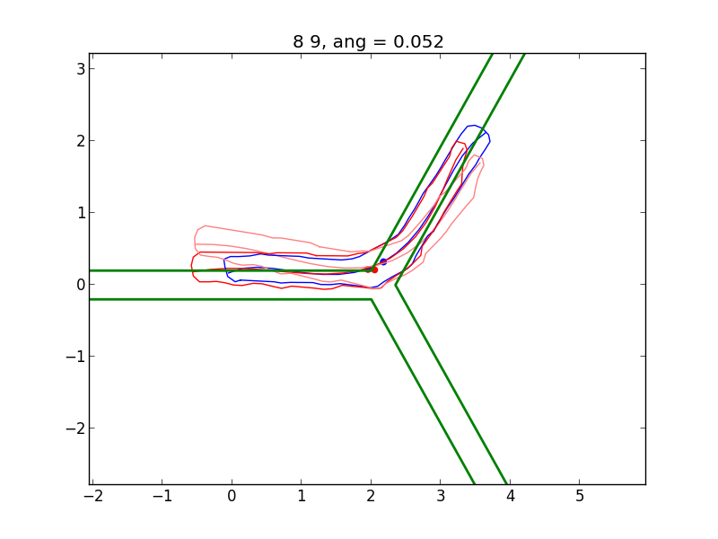

Slide 64
Step Constraint
X_3 and X_4 are new poses after locomotion step
Solve for new location through “step constraint”
X_3 = overlap(X_1, I_1, I_3, d=+\delta)
\delta = 0.5/0.8 ?
Constant \delta is the estimated distance traveled
Image of step ICP fit

Slide 65
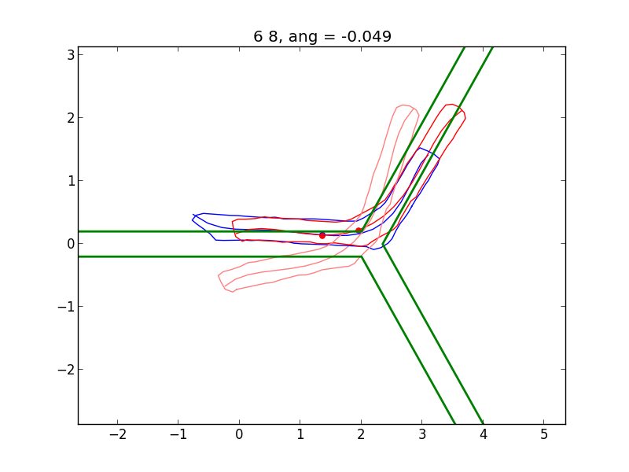

Slide 66
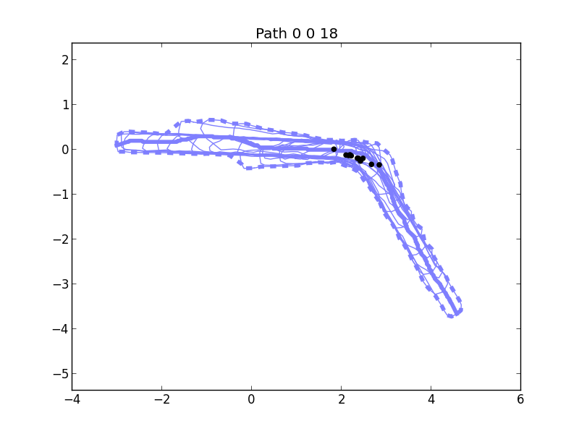

Slide 67
Shortcoming of Naive Approach
Only consistent with last pose
history is ignored
Poses can flair off path
Backtracking
does not stay on past path

Slide 68
Axis Constraint
Compute union of past poses’ posture images
Compute medial axis of the map
New pose must constrain to existing axis
Image of union, medial axis
Image of pose constraint to axis

Slide 69
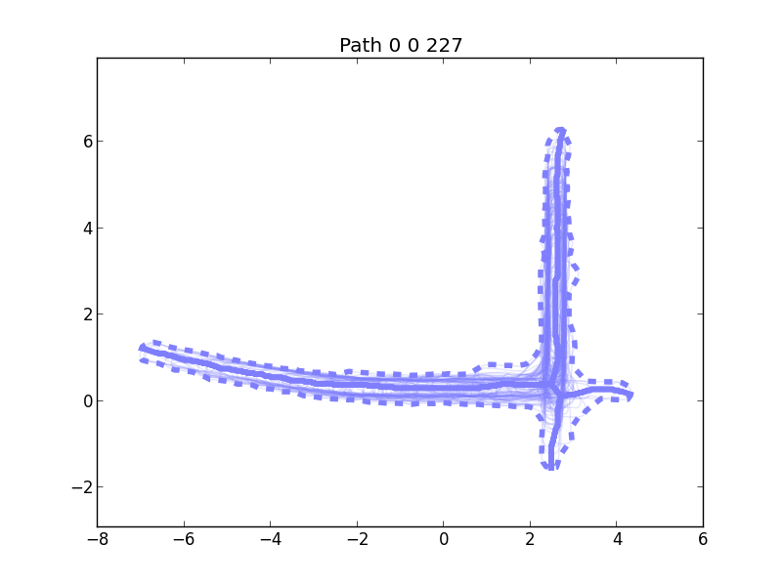

Slide 70
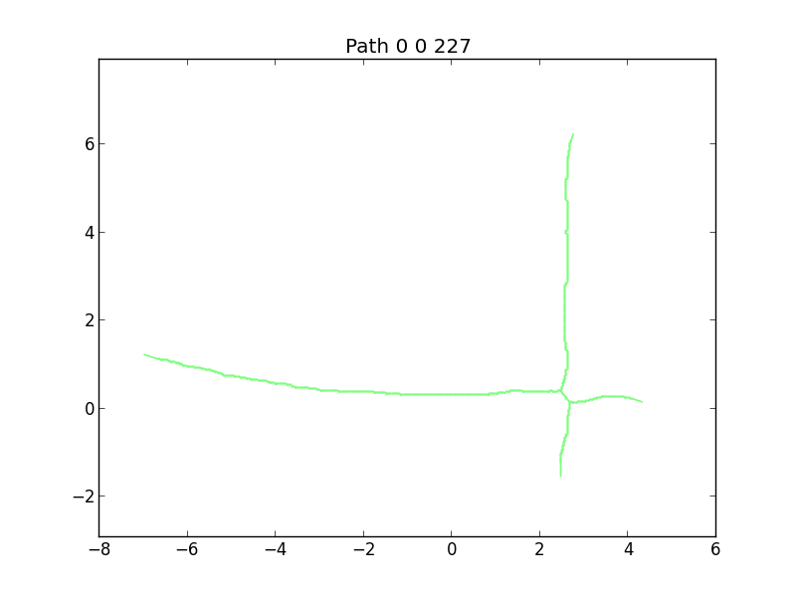

Slide 71
Process of Axis Approach
apply step constraint to make initial estimated pose
apply axis constraint around estimated pose
Image initial guess
Image snap to axis

Slide 72
Mapping Problem (backup)
Actions:
Move commands:
Sensing:
Posture sequence:
Posture Images:
Map Parameters:
Poses:

Slide 73
Sensing Void Space
Position and Orientation
Control and Locomotion
Environmental Landmarks and Features
Building Maps
Mapping with Junctions
Probabilistic Mapping

Slide 74
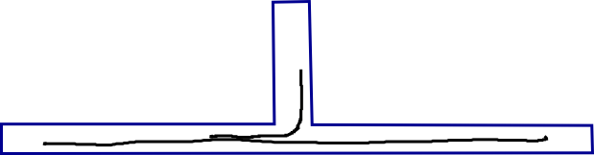
Problem
Axis constraint mapping does not work in environments with junctions
Does not correctly fit to axis with ICP

Slide 75
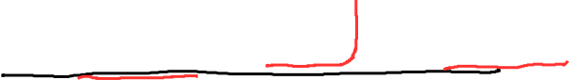
Curve Events
Divergent
Contained
Extending

Slide 76
Branching
Branching event
Create two axes (skeletons now)
No longer a single curve, but a tree (skeleton)

Slide 77
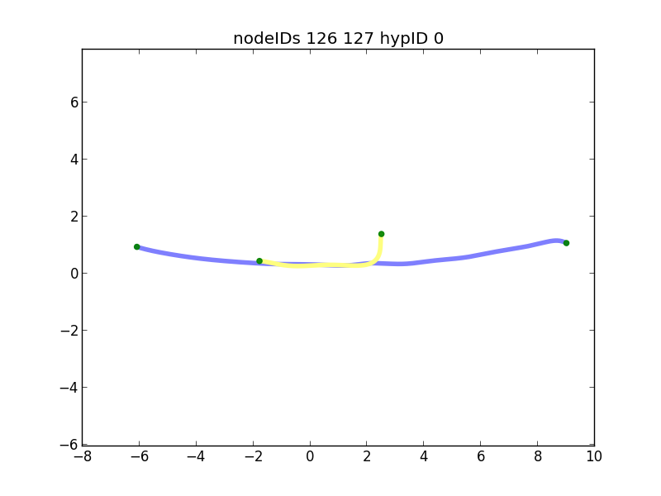

Slide 78
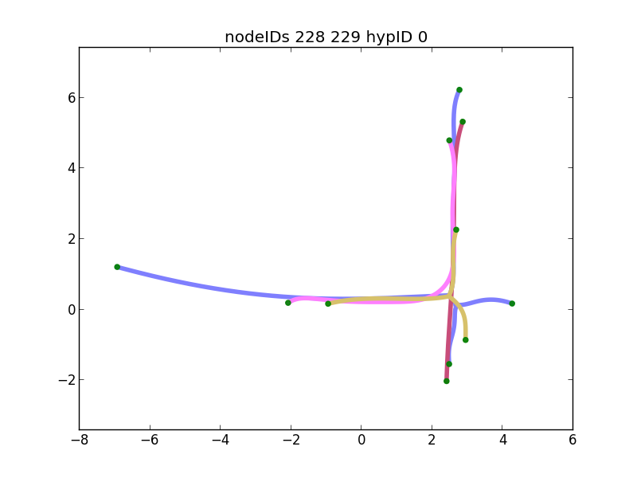

Slide 79
Localization on Skeletons
No longer curve-to-curve ICP
ICP to multiple skeletons
Multiple configurations

Slide 80
Localization Process (how to fit a new pose into past set of skeletons)
Collect set of skeleton terminals
Disregard terminals that are similar or subsumed by another skeleton
Collect (n choose 2) paths between each pair of n terminals
Perform ICP on each spliced path
Evaluate and select “best fit” according to some criteria
DEFINE “SPLICES”

Slide 81
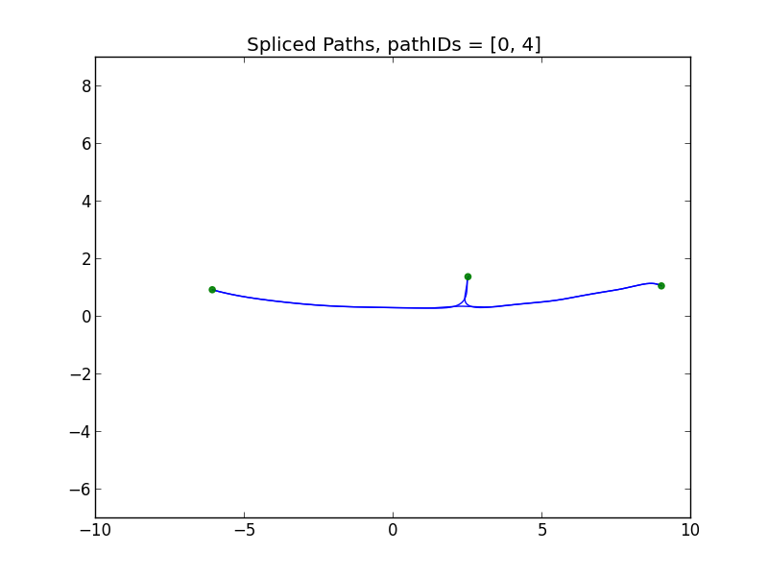

Slide 82
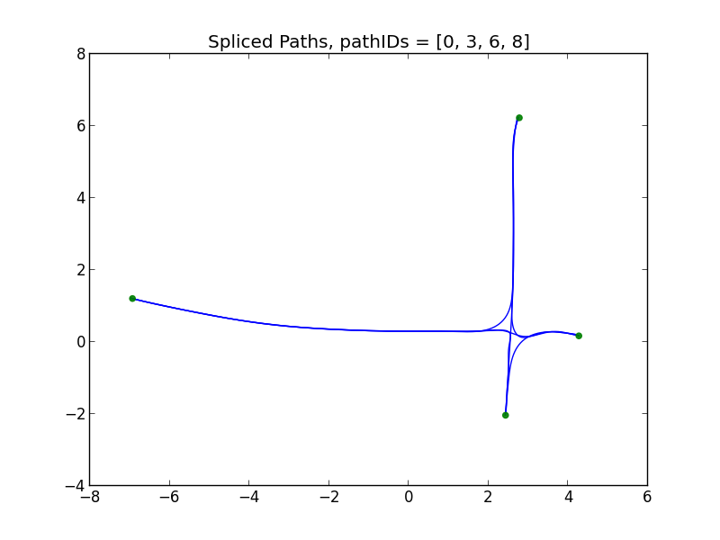

Slide 83
Branch Detection
Given a new pose’s spatial curve, is it branching?
spatial curve is diverging from axis
distance of tip from nearest point on axis is greater than D
other criteria?

Slide 84
Mapping Process
Locomotion Step
Capture Posture Images
Estimate new pose with step constraint
Determine if it branches
add pose to skeleton
Localize new pose to each splice
Select best fit

Slide 85
Sensing Void Space
Position and Orientation
Control and Locomotion
Environmental Landmarks and Features
Building Maps
Mapping with Junctions
Probabilistic Mapping

Slide 86
Problems
Branching in right location?
New branch, existing branch, or no branch?
Pose in right location?
Leads to a probabilistic method

Slide 87
Approach
Sample many poses
Sample many spatial relations between skeletons
Select maximum likelihood state as our map

Slide 88
Parameterization
Possible poses of the new posture image
Skeleton sets: Grouping of all posture image with pose information
Spatial relationship between skeletons

Slide 89
Spatial Transform of Skeletons
Control point on “parent” skeleton
Reduced to 1D parameter space

Slide 90
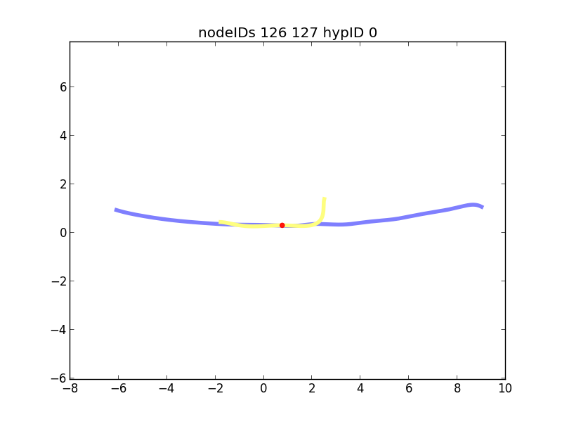

Slide 91
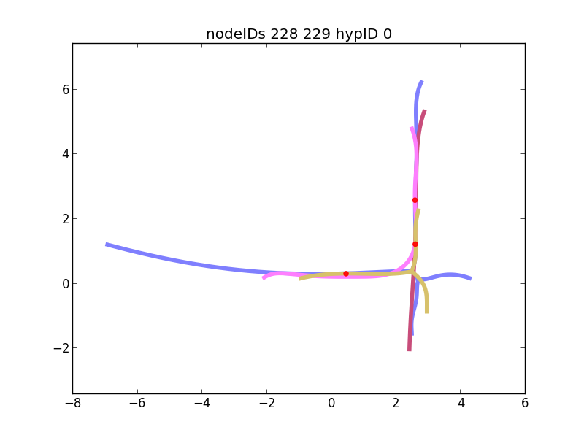

Slide 92
Mapping Problem
Actions:
Move commands:
Sensing:
Posture vector: snapshot of joints time t
Posture sequence: series of snapshots from sweep behavior
Posture Images: union of robot’s geometry under posture sequence
Map Parameters:
Poses:
Skeletons:
Control Points:

Slide 93
Motion Estimation
Sample possible poses uniformly along all splices of the set of overlapping skeletons
Evaluate based on consistency F(x)
Bias likelihood with Gaussian curve representing motion estimated from last best pose
Select best possible pose, keep all past sampled possible poses

Slide 94
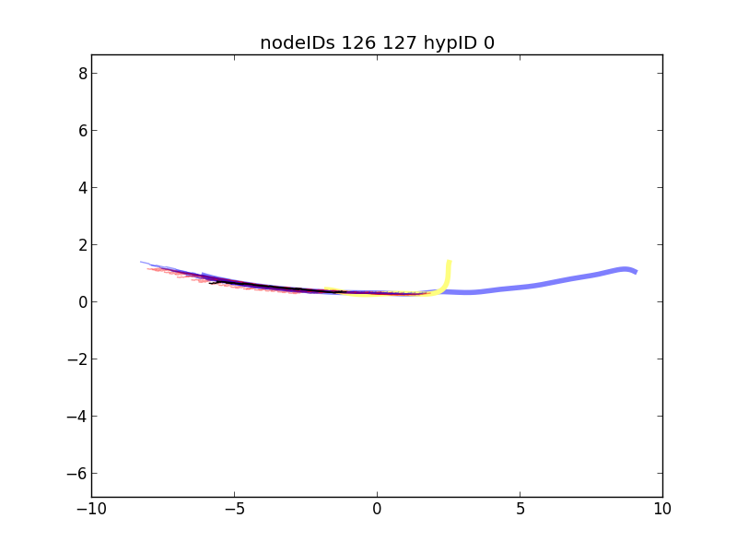

Slide 95
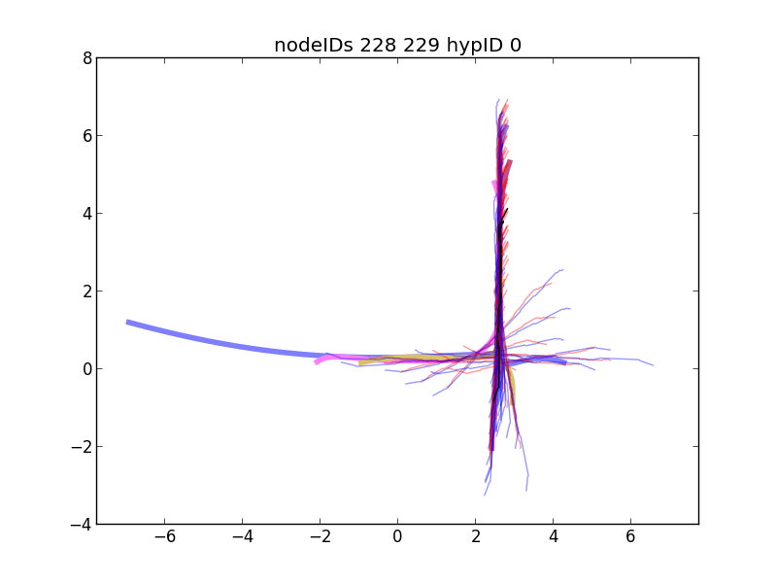

Slide 96
Add to Map
Determine if pose’s spatial curve is diverging
Create new branching skeleton if diverging
Otherwise, add to an existing skeleton

Slide 97
Branching State
Evaluate all branch states
Maximize evaluation function G(T1,T2)
Measures overlap and landmark consistency

Slide 98
Localization
ICP localize all previous samples across all splices
Select maximum evaluated pose H(x)
Correct map the map with max likelihood pose

Slide 99
Merge
Merge skeletons together if they are fully constrained

Slide 100
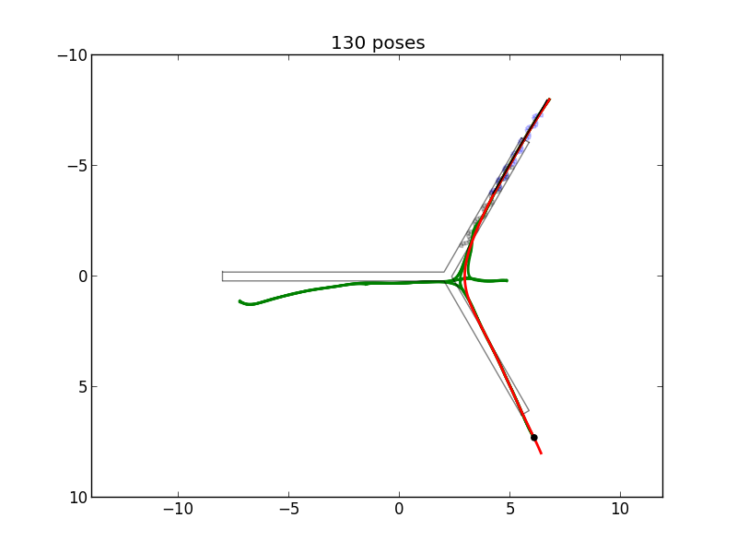

Slide 101
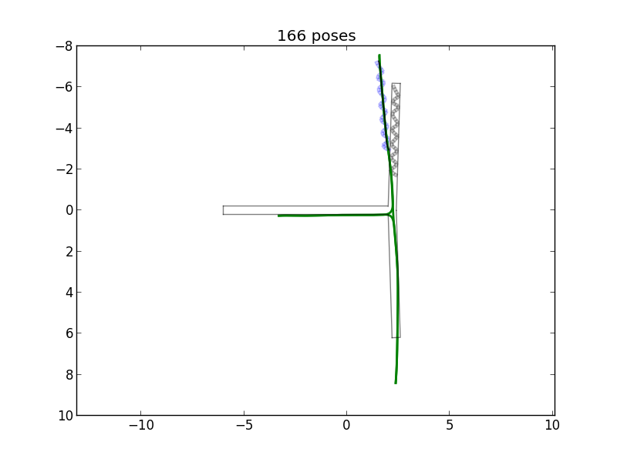

Slide 102
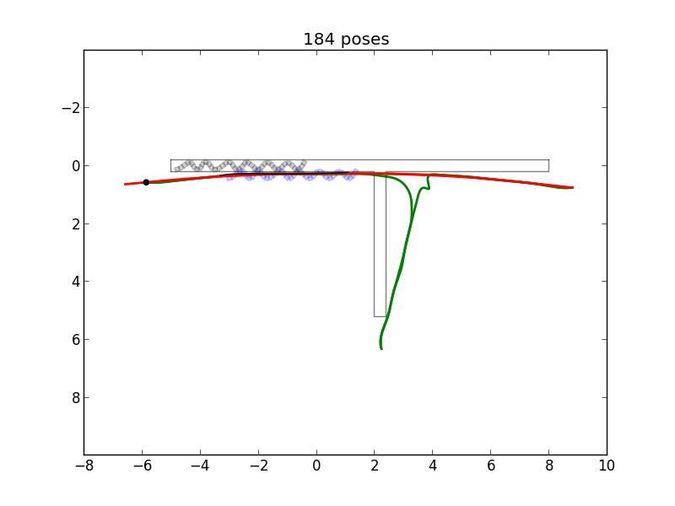

Slide 103
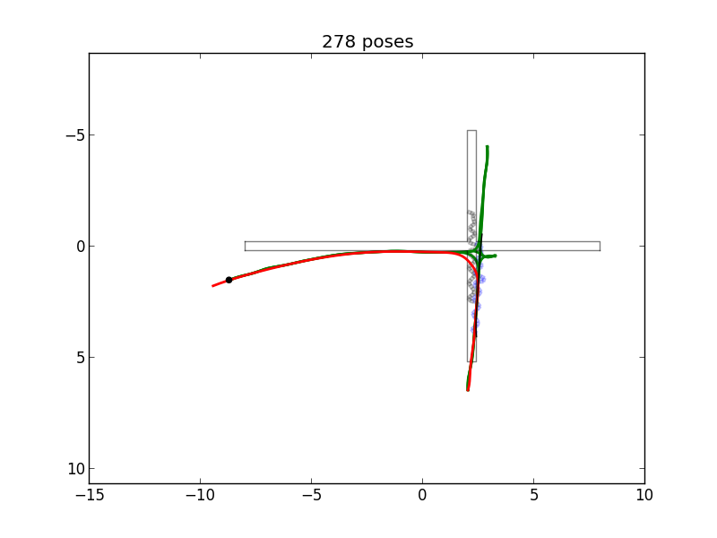

Slide 104
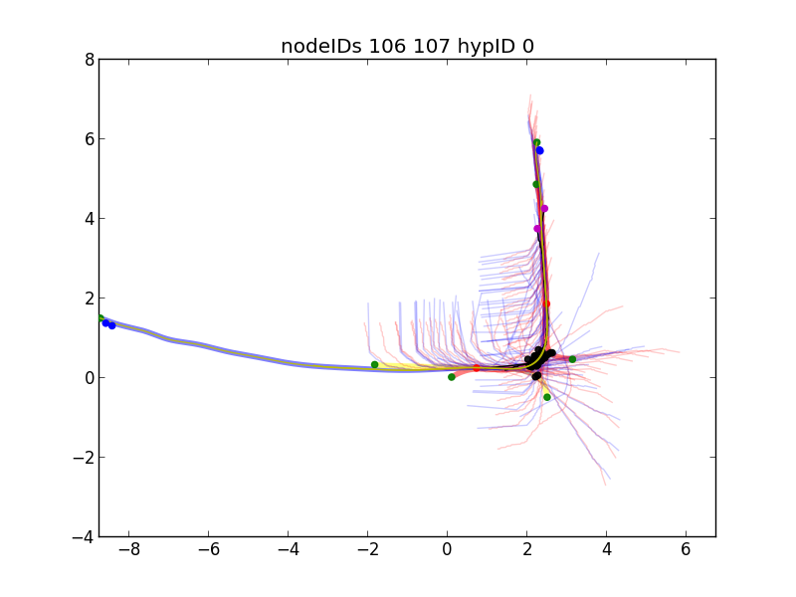

Slide 105
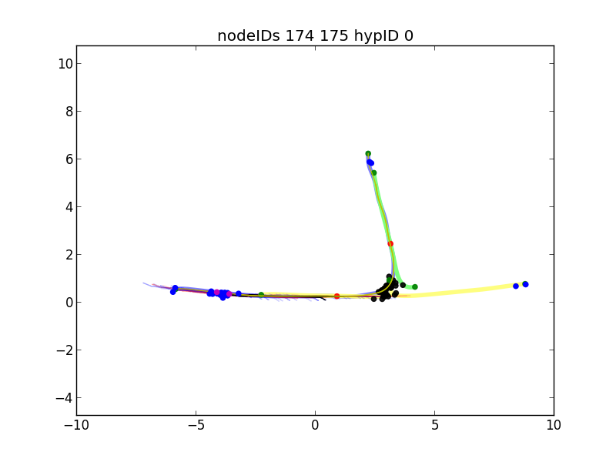

Slide 106
 | T Junction from Bottom | T Junction from Side | Y junction | Right L-junction | Left L-junction | Cross Junction | Straight Pipe | Irregular Pipe | Right 60-junction | Left 60-junction
Forward Locomotion
Backtracking
Single Junction
Multi-Junctions
Navigation
Legend
Success
Partial Success
Not yet demonstrated
N/A

Slide 107
Results
Y_junc: S S C
T_bottom: S S C
T_side: S S S
cross: S S S
60-right: S S S
60-left: S S S
L-right: S S S
L-left: S S S
Straight: S S S
Irregular: S S S
S = success, C = crash

Slide 109
Contributions
Use proprioceptive sensors to map
Use void space to build a map
Map representation using posture images, poses, and overlapping skeletons
Sensing the environment through joint sensors, no contact, vision, or range sensors. First method without exteroception (IROS2009)
Map the environment with no fixed reference frame. Mobile platform
New map representation for confined, tubular, void spaces
Operates without landmark features
Uses holistic shape of the environment
Localization by ICP over medial axes of shapes
Mapping with only highly local information
no sensing at a distances
Detection of junctions that are only partially observable in non-looped environment
Probabilistic representation over space of possible maps
Can map Y junctions, T junctions, X junctions, L and 45deg junctions in non-looping environments
Proprioceptive odometer/dead-reckoning (self-posture motion model)

Slide 110
Conclusion
We developed a method of mapping confined environments when external sensors are not available
We use proprioceptive sensors and the robot’s known geometry
We were able to explore, map and navigate environments with a variety of features in a simulated environment

Slide 111
Challenges
Drift
Length
Loops

Slide 112
Future Work
3D environments
Physical robots
Different type’s of robots
Loose clutter in environment
Switch off between external and proprioceptive
Large-scale environments
Environments with loops

